Slide 1
Project Pirate Island
Jamie Reid’s Use Case Diagram and Flowcharts
Use Case Diagram
Flow Charts
  Stag AI Flowchart
  Door Opening Flowchart
  Save/Load Game Flowchart

Slide 2
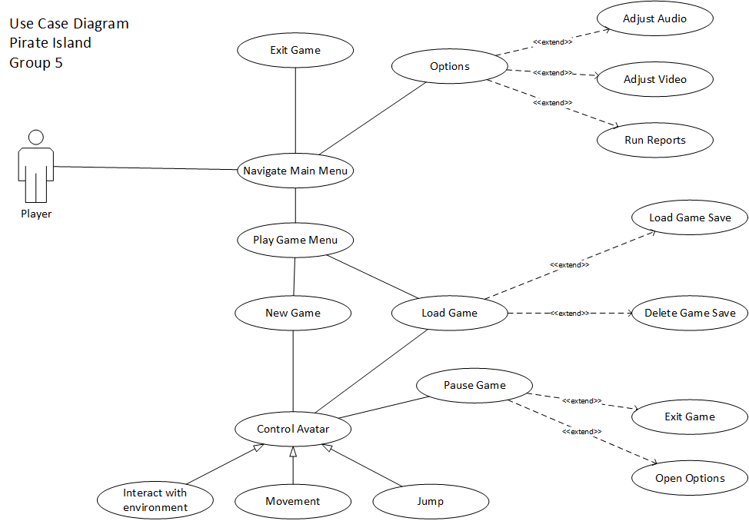

Slide 3
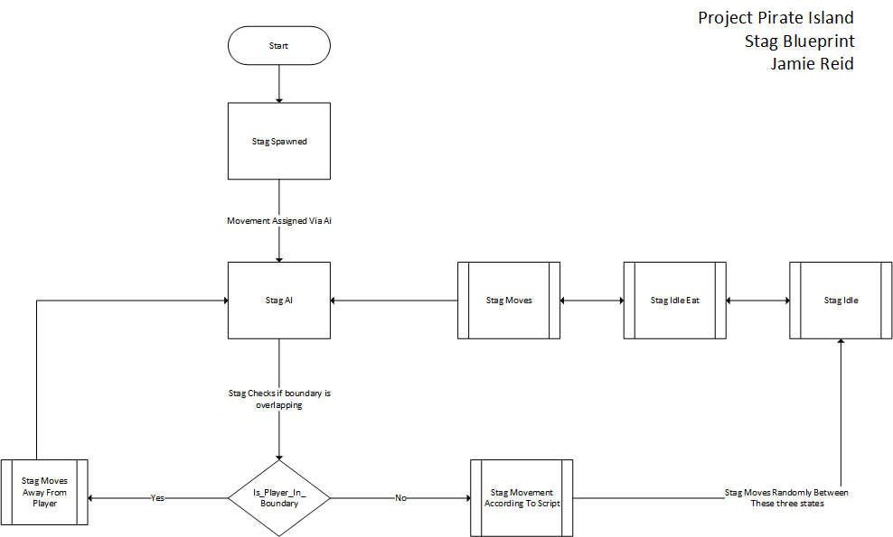

Slide 4
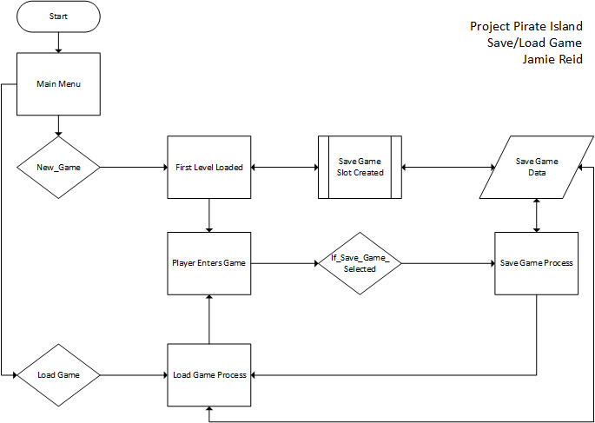

Slide 5
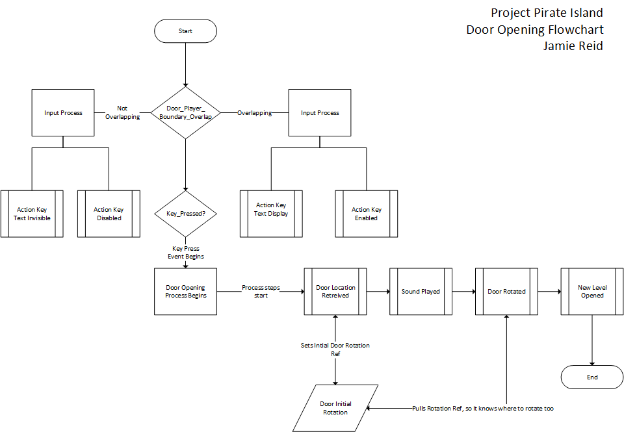

Slide 6
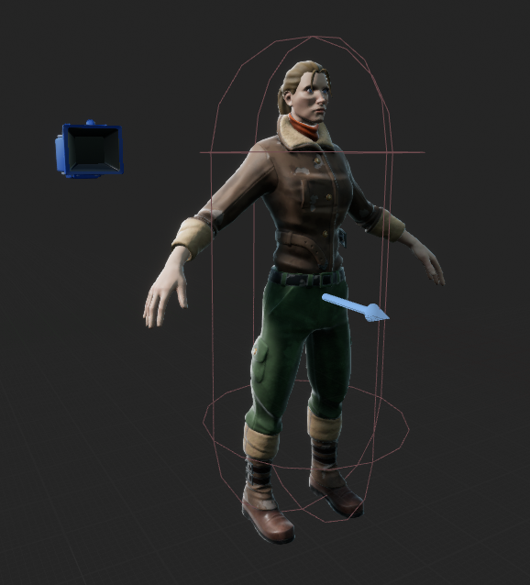
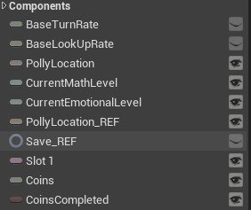
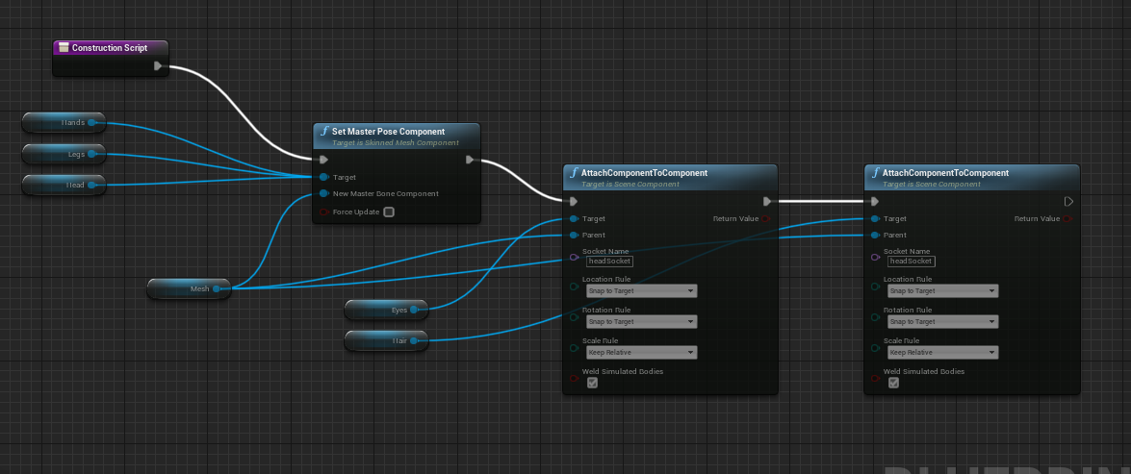
Polly
Mesh Created with StylizedModularCharacter Asset | Animation Taken From ThirdPartyCharacterBP
Variables used to store data for in game use and for saving game.
The construction blueprint below is what is used to create the mesh

Slide 7
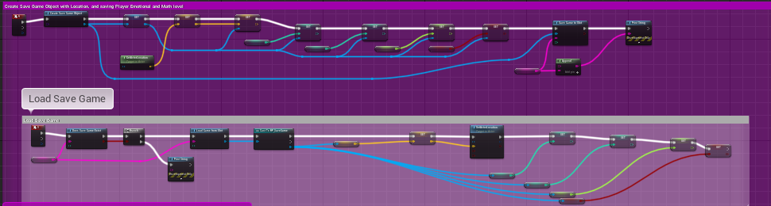
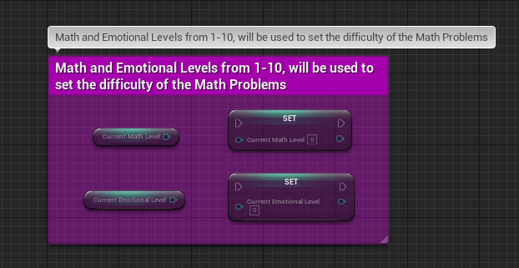
Save/Load Game
Save and Load game is handled by two objects. The Polly object itself and the Save Game Blueprint. The latter just contains all of the variables that need to be saved.
Although these two variables are currently unused, they are important as they will be used to measure two key metrics within the game. The players emotional level and the players math level. These will be used to adjust the difficulty of the minigames accordingly.

Slide 8
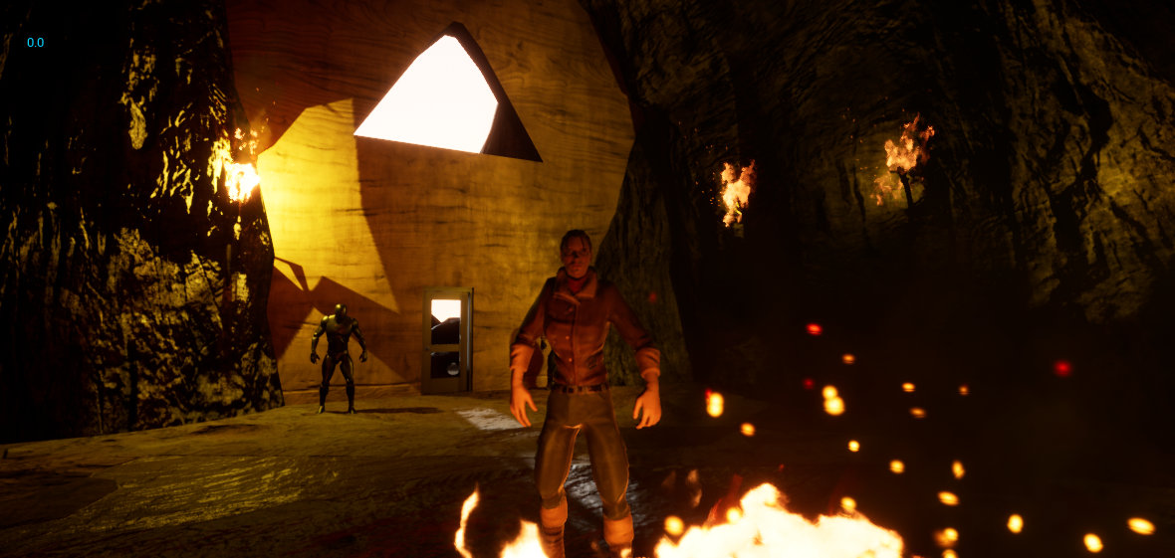
Starting Cave
While this can be used as a starting area for the character, it’s main job in the project so far has been to test different NPCs that can be indoors as well as other blueprints.
The torches and the fire were created using the same assets, singular stick meshes and the fire asset from StarterContent.

Slide 9
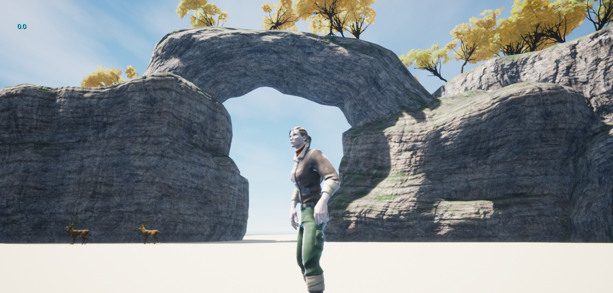
Starter Island
The starter island was a small area that I designed to allow testing of minigames, NPCs, and other outdoor events while the main Island was being worked on.
This will be integrated into the final game as a tutorial island, where the user experiences what the game has to offer and how to interact, before setting sail to the main island.
Featured currently on this small island is a quest to collect coins, which after completing, allows the user to entire into a minigame. The island is accessed via an animated door from the starter cave.
Also, featured here, are two stag deer that move at random, switching between different animations. They will move away from the user if they get too close. This feature can be easily replicated to many other animals

Slide 10
Where do we go from here?
The project so far has taken baby steps while each of the group members learn to utilize the Unreal Engine. However, now that we have gotten to grips with it and created a skeleton of what we need for the main game the goals are as follows:
Populate the main Island
Implement the Math/Emotional Level system that we can run reports from
Create a more diverse and alive world with many more different NPCs and animals that are part of a living, breathing world.
Ensure the menu system is intuitive, easy to understand and use and has access to the reporting system.

